Slide 1
Colours in Space
HCI project 2012 | Team 9 | Hanna Schraffenberger
Harpo ‘t Hart
Philipe Louchtch – de Raadt

Slide 2
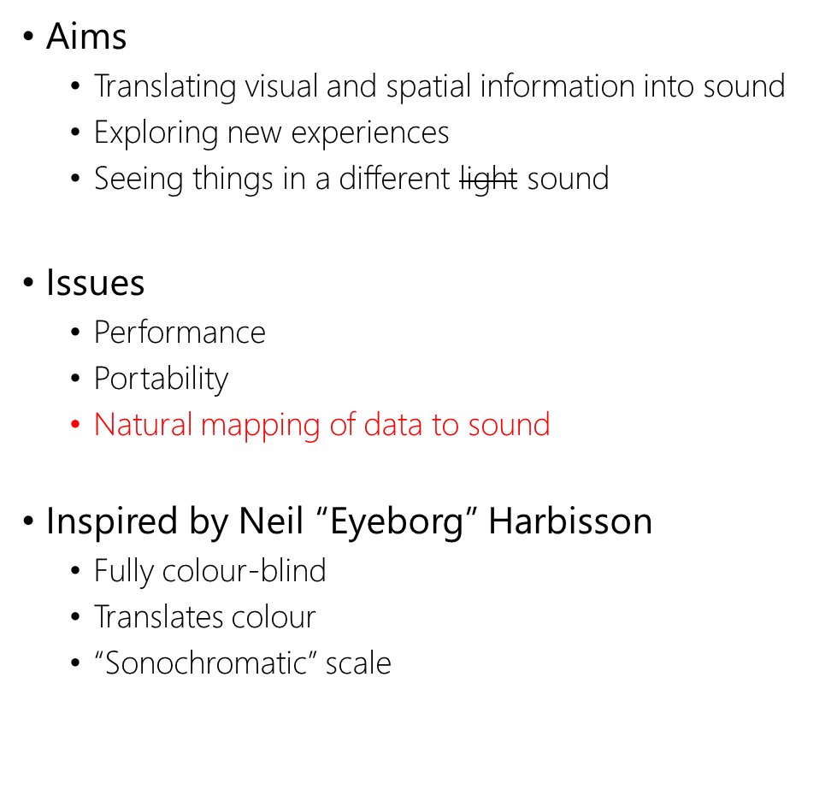
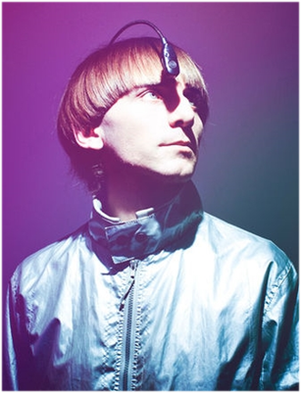
Introduction

Slide 3
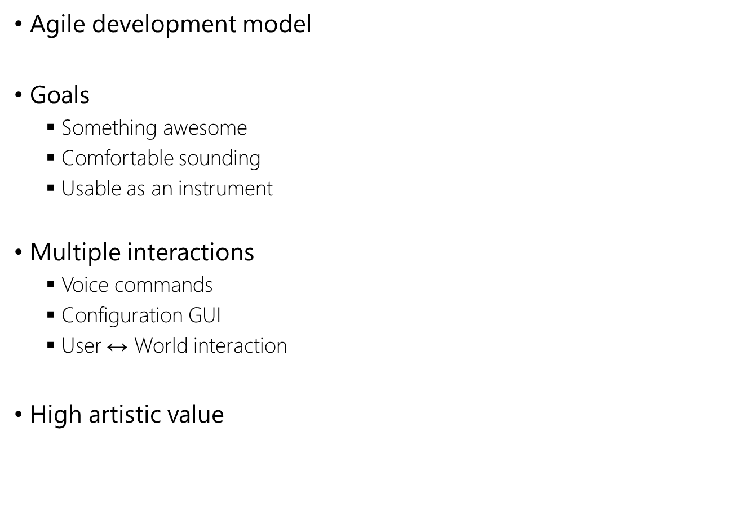
Product Plan

Slide 4





Product Plan
Development platforms and environments
Why?
SuperCollider

Slide 5
User Analysis
User Group
  Artistically inclined people
    Performers
    Artists
  Are open to new experiences
  Creative usage of the product
  Less knowledgeable about technology
Expectation
  Instrument for performing
  Product able to be integrated into art

Slide 6
User Analysis
User Evaluation
<dingen over eval hier>

Slide 7
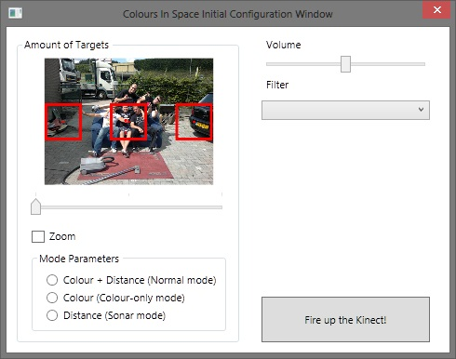
Paper Design
Interaction is auditory
  Voice commands are a logical choice
Configuration GUI available
Interfaces must be easy
  Advanced controls are an option
  (user eval 1) <over de numpad>
First prototype working already
GUI used for user eval 1

Slide 8
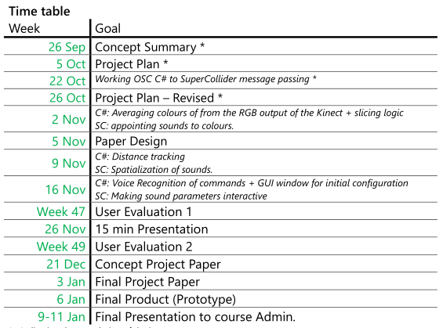
Working Schedule
  Schedule according our Project Plan

